Slide 1
AI Job Automation Risk Analysis
Workforce Skill Shift Study
Name: Rableen Kaur Kapoor

Slide 2
OBJECTIVE
Analyze automation risk across industries
Understand AI impact on workforce
Identify key relationships in data
Derive meaningful insights

Slide 3
DATASET OVERVIEW
15,000+ records
20+ variables
Mixed dataset (Categorical & Numerical)
Covers industries, job roles, AI impact

Slide 4
EXCEL-BASED ANALYSIS
PIE CHART
Top 5 Industries at Automation Risk
BAR CHART
Average Automation Risk by Industry

Slide 5
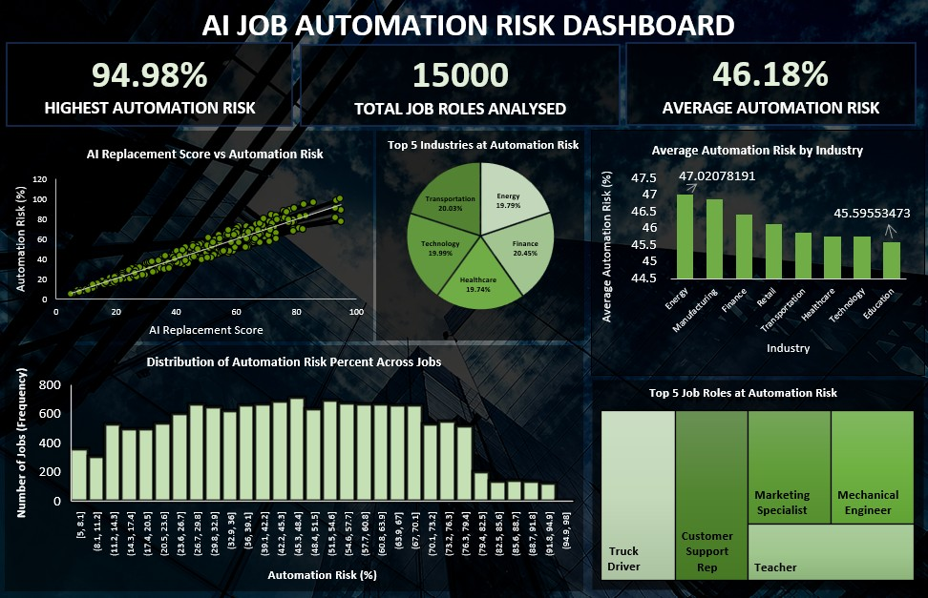
EXCEL DASHBOARD

Slide 6
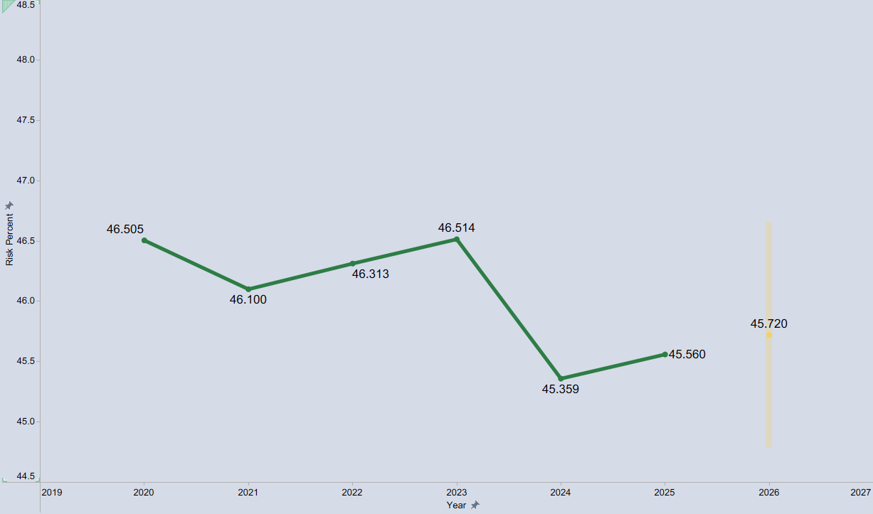
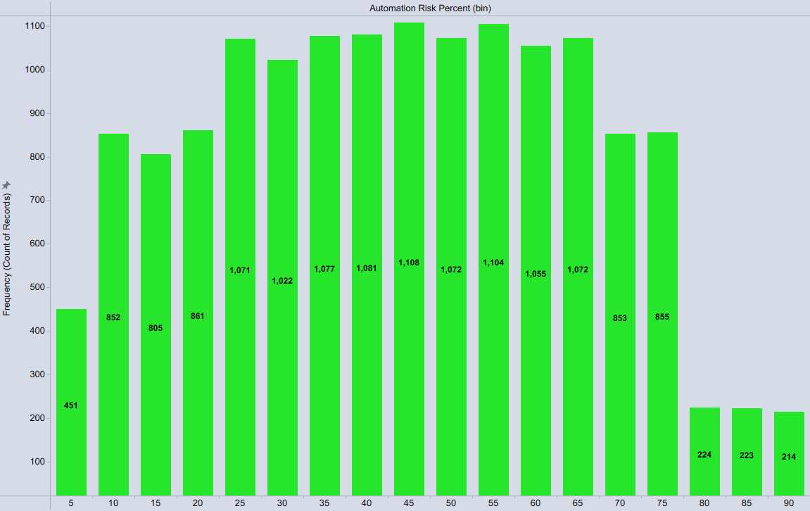
TABLEAU-BASED ANALYSIS
LINE CHART
Automation Risk Trend and Forecast
HISTOGRAM
Distribution of Automation Risk %

Slide 7
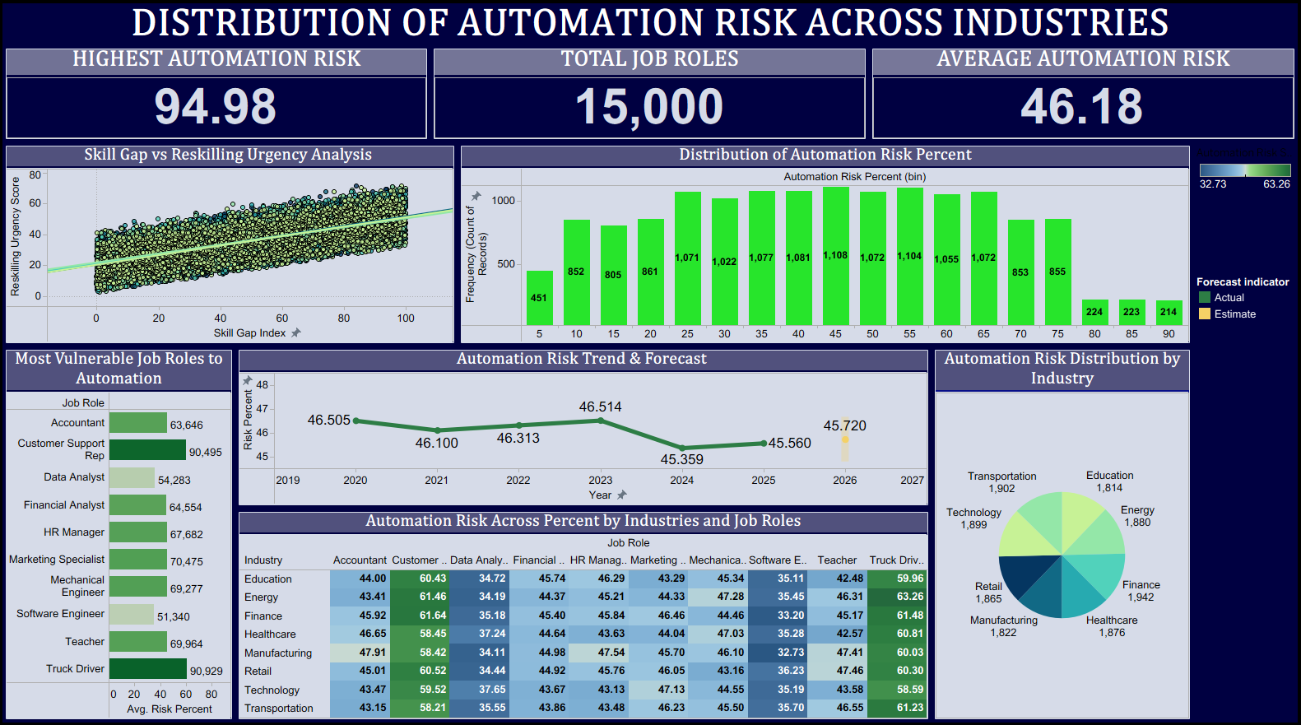
TABLEAU DASHBOARD

Slide 8
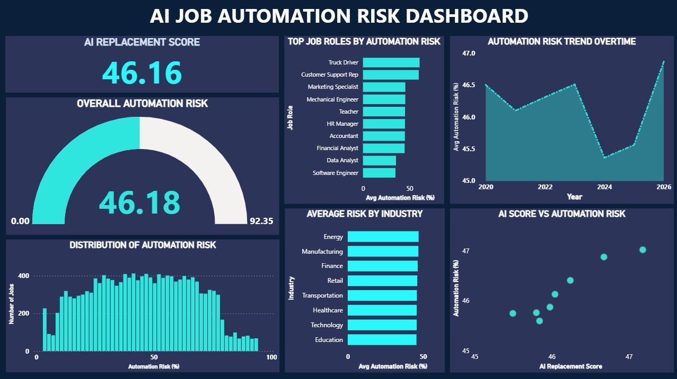
POWER BI DASHBOARD

Slide 9
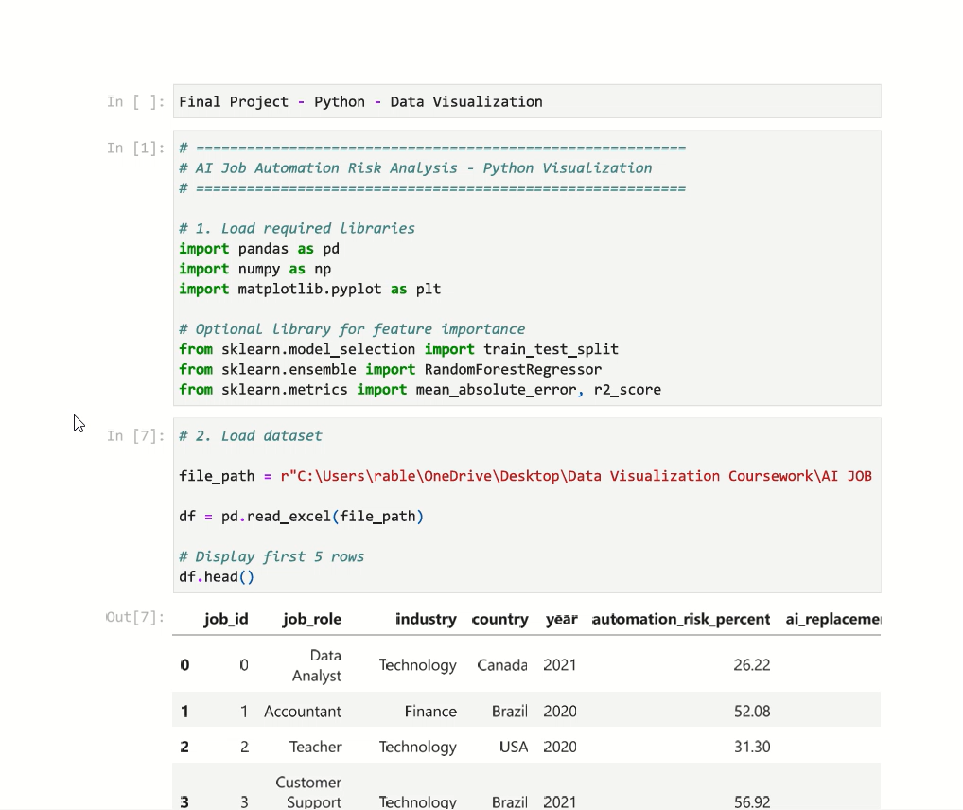
PYTHON CODE

Slide 10
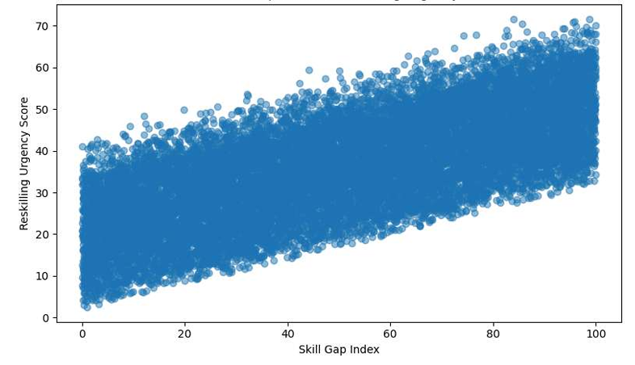
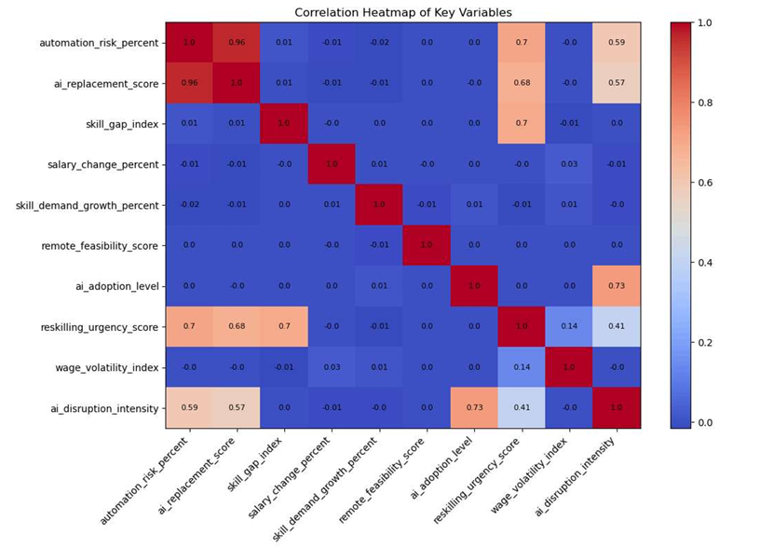
PYTHON-BASED ANALYSIS
SCATTER PLOT Skill Gap Index vs Reskilling Urgency
HEATMAP Correlation Map of Key Variables

Slide 11
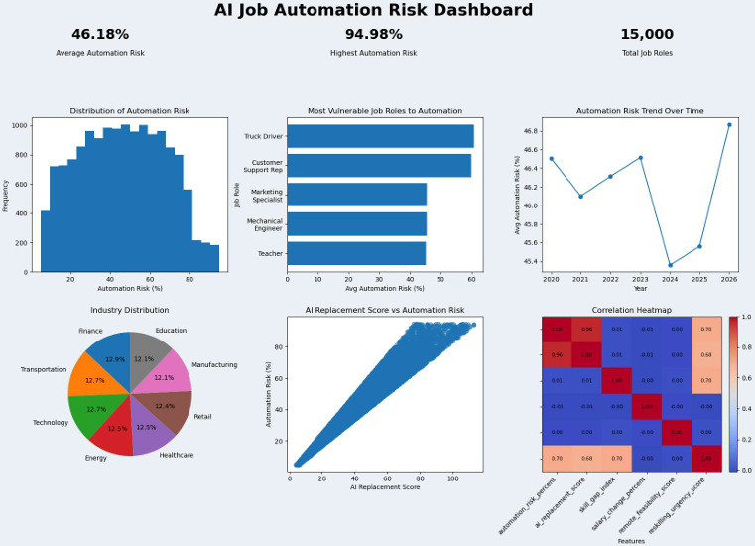
PYTHON DASHBOARD

Slide 12
FINAL INSIGHTS
Automation risk is widespread AI strongly impacts job roles Majority jobs fall in moderate risk Reskilling is essential
AI is not just replacing jobs, it is reshaping the workforce.

